Slide 1

Review:
Learning to Scaffold the Development of Robotic Manipulation Skills
Deepak Raina
2019MEZ8497
Notes:
Good morning, I am going to present my review paper presentation. The title of paper is “Learning to Scaffold the Development of Robotic Manipulation Skills”.

Slide 2

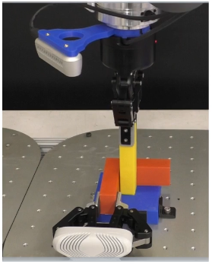
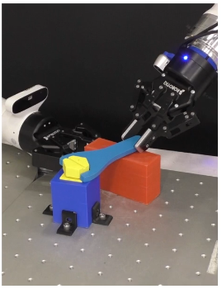
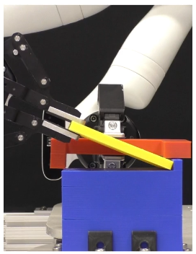
Problem Statement
Autonomously discovery of how to ease robotic manipulation skill learning
Peg Insertion
Wrench Manipulation
Shallow-Depth Insertion
Notes:
The paper proposes an approach to automatic learning of contact-rich robotic manipulation skills like peg insertion, wrench manipulation and shallow-depth insertion by placing the fixture optimally. In all these tasks, fixture is shown as red color block in the figure. These skills will make the robot more versatile and robust, while current robots require to adapt to the environment to match their limited abilities.

Slide 3
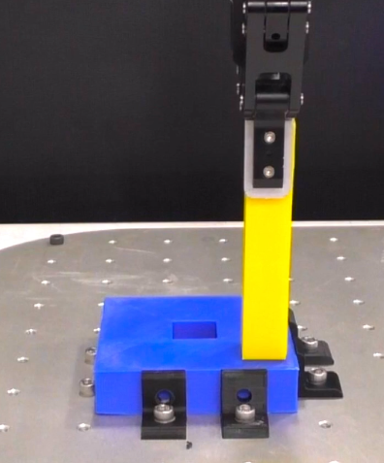
Challenges
Peg Insertion task without fixtures
Difficult to learn the accurate and reliable path for a robot
High dimensionality of state and action space will drastically increase the learning time
Uncertainty due to noisy sensors
Notes:
Take the peg insertion task for example, it will be difficult to find the accurate and reliable path to guide the robot to accomplish the task precisely. This is due to high dimensionality of the state and action space. It will make robot to explore lot of wrong or undesirable motions and hence the learning time will increase drastically. That means, it will take lot of trials for robot to figure out how to do these tasks correctly. The inherent noise in the sensors and motors will also cause inaccurate perception and motor control, thereby increasing training time further.

Slide 4
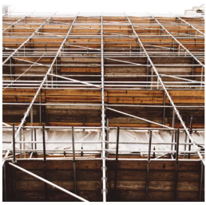

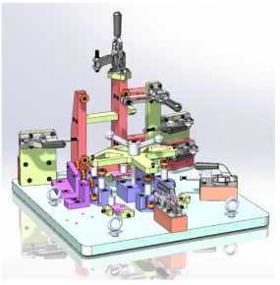
Solution Inspiration
Human Learning principle, known as scaffolding
Human leverage environmental constraints to ease various manipulation tasks
Construction Scaffolding
Training Wheels
Industrial Fixtures
Notes:
Human beings encounter lot of such challenging manipulation tasks but they are able to leverage the environment to ease the various tasks. For example, in order to build the high-rise buildings, construction workers use scaffold to temporarily support the material and get access to heights and areas. Parents provide training wheel to their children to help them learn how to ride the bicycles. And in industries, workers use fixtures to guide the robots in manufacturing procedures.

Slide 5
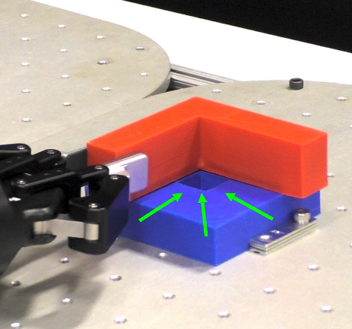
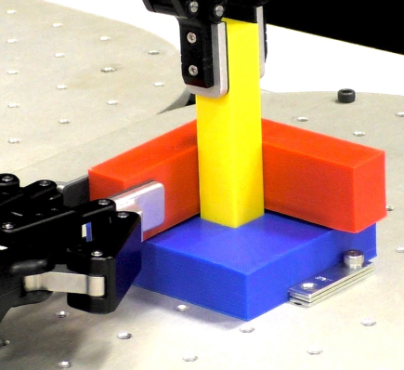
Methodology
Physical Scaffolding
Enable the robot to modify its environment by using fixtures
Notes:
Inspired by the human scaffolding learning principle to do various tasks, they have used physical scaffolding to learn robotic manipulation tasks. It will enable the robot to modify its environment by placing the fixtures automatically. As shown in the figure, when the fixture is placed, the peg insertion task suddenly becomes easy to not only execute but also to learn, because some robot motion directions have been restricted by the fixture.

Slide 6
Prior Art
Learning to leverage the environment
Kazemi et al. (2012), Toussaint et al. (2014), etc: Environmental contact constraint has been used to propose robust grasping and manipulation tasks
Learning robotic manipulation skill
Luo et al. (2019), Lee et. al (2019), Kim et. all (2019), etc: Deep reinforcement learning framework has been used for learning manipulation tasks like insertion, assembly, tool/in-hand manipulation
Contextual Bandits with continuous action and discontinuous reward
Krishnamurthy et al. (2019): They addressed the challenge of discontinuity in the action-to-reward function by mapping each discrete action into a well-behaved distribution with no continuity assumptions
Notes:
Let us have a look at the related works mentioned in the paper. Earlier, there have been attempts by researchers to learn the robotic grasping and manipulation tasks by leveraging the environment, but in all these works robots interact with environment using limited set of constraints and predefined way to exploit them. In contrast, this paper proposed a data-driven learning framework for robots to automatically discover and learn how to change and leverage the environment with self-supervision. Researchers have also proposed various learning approaches based on Deep-RL for complex manipulation tasks like insertion, assembly and in-hand manipulation. But this paper’s approach is focused on actively changing the environment to support the manipulation skill learning.

Slide 7
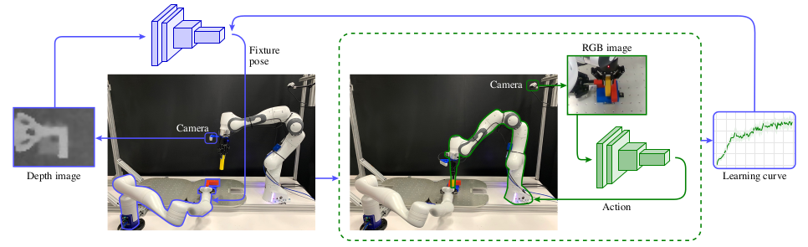
Technical Approach
Two loop learning process
Outer loop: Fixture pose selection
Inner loop: Manipulation skill learning
Notes:
To make the robot autonomously learn the manipulation skill, this paper proposed a two loop learning framework. In the outer loop, robot learns how to place the fixture. Once the fixture is placed, robot switches from outer loop to inner loop process, where it learns to perform the manipulation skill using reinforcement learning algorithm. The accumulated reward is calculated to reflect the learning of manipulation task, given the fixture pose. The reward is then sent to the outer loop to guide the fixture pose selection. The experimental setup is shown in the figure. They have used two robots. The robot on left is holding the fixture and has top view of depth image as input. The accumulated reward during manipulation skill training by the right robot is used as a reward to guide the left robot to find the optimal fixture pose.

Slide 8

Outer loop: Fixture pose selection
Contextual Bandit Problem
State: Depth image (context)
Action: Fixture pose (continuous)
Reward: Inner loop accumulated award (discontinuous)
Notes:
The outer loop fixture pose selection has been formulated as contextual bandit problem, which is one of the novel contribution of this work. The state is depth image, the action is fixture pose and its continuous. The reward is inner loop accumulated reward. However the reward is discontinuous with respect to the action. The goal is to find out the optimal placement of fixture autonomously. The challenging part of this problem is having discontinuous action-to-reward function.

Slide 9
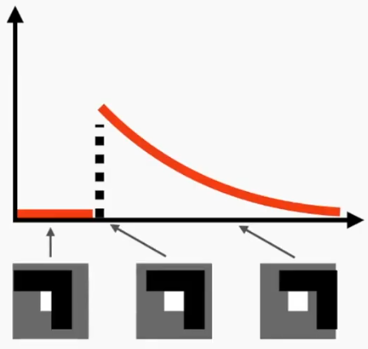
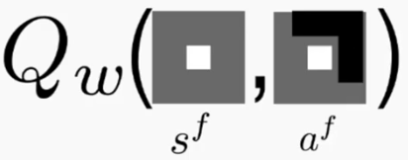
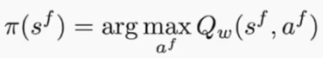
Outer loop: Fixture pose selection
Discontinuous Q-function
Reward
Testing time
Action
Notes:
Let me give more details on discontnuous Q-function. We approximate the Q-function Q_w, while trying to learn Q-function. So this basically returns reward after taking an action a, with depth image as context denoted by s. Once we have this approximation, we can use it at test time to get action given the context using the formula shown. The problem here is that the Q-function that we are trying to estimate is actually discontnuous. On y-axis, we have a reward and on x-axis, we have a placement of the fixture. On left depth image, the fixture is covering the hole, so robot will never be successful in inserting the peg, thus will not get any reward during training. Suddenly when fixture is perfectly aligned with hole, it will get maximum reward and this reward will start to decrease when fixture is suboptimally placed. So we have discontinuity in reward function as shown in figure. And one of the novel contribution of this paper is handling such kind of discontinuities in reward function.

Slide 10
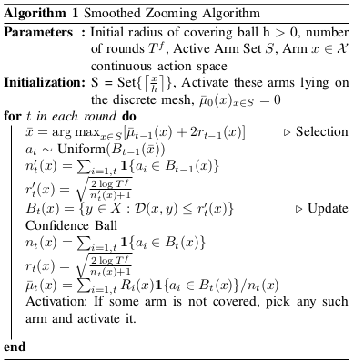
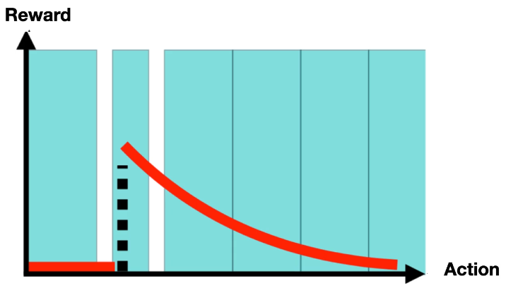
Outer loop: Fixture pose selection
Smoothed zooming algorithm
For smoothing the discontinuous reward function and learning Q-function
Multi-arm bandit problem
Reward
Action
Notes:
In order to solve this problem with continuous actions and discontinuous reward function, they proposed a novel smoothed zooming algorithm. In this, they first covered the continuous action space with countable number of covering balls with the given radius, as shown blue color in the graph. Then they solved it as a multi-arm bandit problem. They have used upper confidence bound (UCB1) rule to select the one covering ball. Once the ball is selected, the action is uniformly sampled within the ball. In this way, they are able to smooth the discontinuous reward function. Meanwhile the radius of selected ball starts to shrink and it may lead to new exposure areas in the action space. Then the new covering balls is initialized to cover these exposure areas and the process keeps on repeating till maximum number of iterations is reached.

Slide 11
Inner loop: Manipulation skill learning
Episodic Reinforcement Learning (RL) problem
State: RGB image
Objective: Learn a policy and maximize the cumulative reward
Algorithm: Actor-critic A3C
Output: Operational space end-effector pose
Notes:
The inner loop manipulation skill learning has been formulated as episodic RL problem. The robot receives an RGB image, takes a action, receives a reward and moves to next state. The objective is to learn a policy and maximize the cumulative reward. They have used a variant of actor-critic algorithm, known as Asynchronous Advantage Actor Critic algorithm, also known as A3C, to learn the optimal policy. The “Critic” estimates the Q-value function. The “Actor” updates the policy distribution in the direction suggested by the Critic. The A3C implements parallel training where multiple workers in parallel environments independently update a global value function, hence known as “asynchronous.” One key benefit of having asynchronous actors is effective and efficient exploration of the state space.

Slide 12
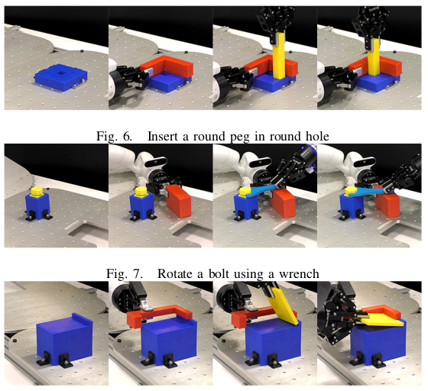
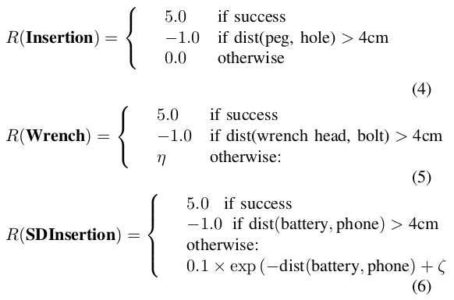
Results
Simulation (PyBullet) and real-world experiments
Peg Insertion
Wrench Manipulation
Shallow-depth Insertion
Notes:
To test the efficacy of their framework, experiments have been conducted in both real and PyBullet simulation. In the peg insertion task, fixture will prevent the peg from slipping past the hole. If the peg is inserted, the task is successful and robot receives a reward of +5. Otherwise it gets reward of -1 if distance between peg and hole is greater than 4 cm else it gets 0 reward. In wrench manipulation, fixture provides the support for wrench to stay horizontal. Reward function similar to peg insertion has been formulated. In shallow depth-insertion, the task is similar to battery insertion in phone. The fixture in this task prevents the translation and rotation of cuboid into the slot. The neta and epsilon term here represents the degree of rotation of bolt and battery

Slide 13
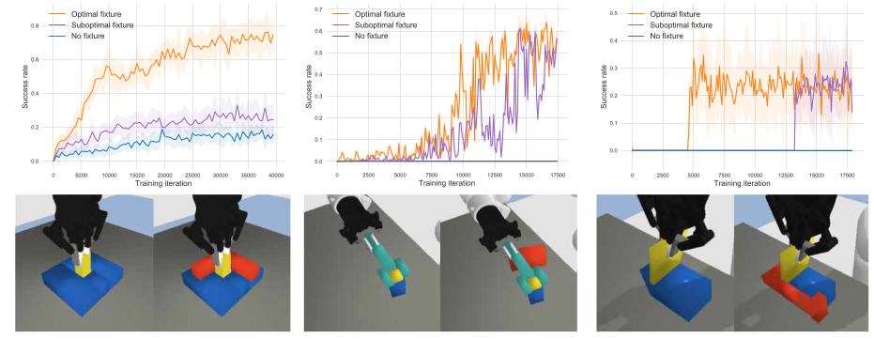
Results
Task performance evaluation with and without fixtures
Notes:
They have evaluated the performance of robot with and without fixtures. They plotted the learning curves for inner loop manipulation learning process. With optimal fixture pose, curve is shown in orange, for suboptimal and no fixture, it is shown in purple and blue. It can be noticed that orange line is always above the blue line indicating significant boost-up in learning with fixture for these manipulation tasks.

Slide 14
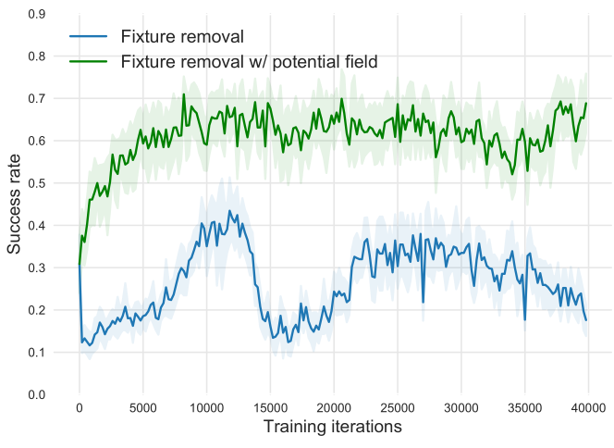
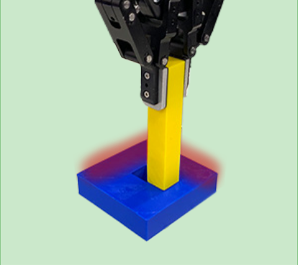
Results
Task performance evaluation without fixtures
Fixture (hard constraints) replaced with artificial potential field (soft constraints)
Notes:
They also demonstrated how robot can benefit from scaffolding principle. In this, the hard constraints induced by the fixture has been replaced with a virtual potential field i.e soft constraints during training. Potential field has been maintained according to the geometry of fixture sensed by depth camera. The training starts from optimal policy obtained with fixtures. Then the fixture is gradually removed by other robot to transfer the skills with fixtures to skills with virtual potential field. They found that with the baseline method, performance initially drops to 30%, but drops further to around 10% as the fixture moves farther away. With the potential field, the performance still drops to 30% initially, but climbs back up to 70% when the fixture is fully removed as it learns to handle the absence of the physical fixture.

Slide 15
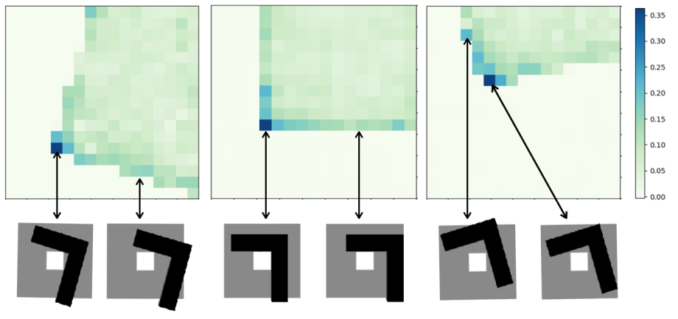
Results
Visualized Q-map for fixture pose selection
Notes:
They also visualized the Q-value of outer loop learning process. These are three images of the Q-value in peg insertion task. Each image represents the Q-value and various positions given the same fixture orientation values. The darker the pixel value is, better the corresponding fixture position is. It can be noticed in the figure that optimal fixture poses corresponding to darker pixel values are able to constrain the possible motions and significantly reduce the uncertainty of environment.

Slide 16
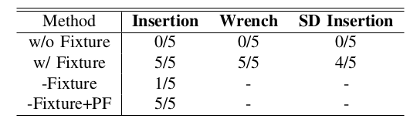
Results
Generalization ability
Directly tested the simulation policy in real world
Used domain randomization, random object positions, textures and lighting condition
Reported success rates for varying peg shapes and sizes
Notes:
One of the most convincing result is the generalization ability of framework across varying peg dimensions. This has been achieved using domain randomization, randomize object positions, textures and lightning conditions during training. The models trained without fixtures fail in all tests, reflecting the difficulty of these manipulation tasks. The models trained with fixtures successfully finish almost every trial for each task, if not all. They also compared the models trained on fixture removal for the peg-insertion task. The baseline fails to insert the peg into the hole, while their model trained with the potential field is able to maintain the skill.

Slide 17
Thanks
Notes:
With this, I would like to conclude my presentation. Thanks.

